Slide 1
Colours, Active Programs, and Coordinate Transforms

Slide 2
Color background, shapes, text
Control transparency
Understand two basic color modes: RGB vs HSB
Set color range

Slide 3
Color Representation
You can use different colors for your drawings and the background.
You have two options:
  Grayscale: different shades of gray
    A single digit (integer) ranging from 0 (black) to 255 (white)
  Color : to represent a required color using a color model such as RGB or HSB (aka HSV).
0
64
128
192
255

Slide 4
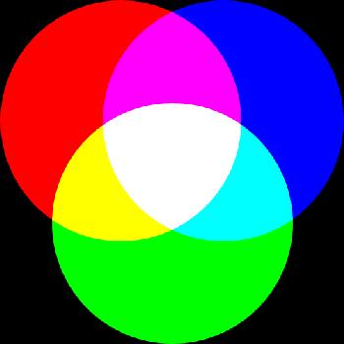
RGB Color Model
RGB is a color that is a result of mixing three primary colors, Red, Green, and Blue.
  The amount of each color is represented by a value
  from 0 (none) to 255 (max).
Examples:
Note: when you have same amounts, you get a shade of gray
 | RED Component | GREEN Component | BLUE Component
Red | 255 | 0 | 0
Green | 0 | 255 | 0
Blue | 0 | 0 | 255
White | 255 | 255 | 255
Black | 0 | 0 | 0
Yellow | 255 | 255 | 0
Cyan | 0 | 255 | 255
… | … | … | …

Slide 5
Color Question
What is the best description of RGB color (210,0,190)?
  a shade of purple
  a shade of yellow
  a shade of blue
  a shade of green
  a shade of gray

Slide 6
Color Question
What is the best description of RGB color (120,120,120)?
  a shade of purple
  a shade of yellow
  a shade of blue
  a shade of green
  a shade of gray

Slide 7
How to Color?
You can color the following items:
  background using background() function.
  outline and fill of a shape using stroke() and fill() before drawing the shape.
Use either
    one argument for gray shades. e.g. fill(0) is black fill.
    three arguments for RGB color. e.g. fill(255,0,0) is red fill
      Note that RGB mode is used by default.
Once you set a color, it applies to all shapes drawn afterwards.
Default values are used if no colors are chosen.
  background: 204 (light gray), stroke: 0(black), fill: 255 (white).
You can use noFill() or noStroke() functions to disable filling or outlining a shape.

Slide 8
List of color functions so far…
background()
  Set background color
stroke(), noStroke()
  Set stroke (line) color
fill(), noFill()
  Set filling or text color

Slide 9
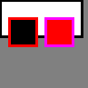
Colourful Shapes
background(128);
strokeWeight(3);
fill(255);
rect(0,0,90,40);
stroke(255, 0, 0);
fill(0);
rect(10,20,30,30);
stroke(255, 0, 255);
fill(255, 0, 0);
rect(50,20,30,30);
Q: Can you link each statement to one of the output shapes?

Slide 10
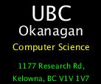
Colourful Text
background(0);
size(140,120);
textAlign(CENTER);
textSize(28);
text("UBC", 70, 30);
textSize(18);
text("Okanagan", 70, 50);
fill(255,255,0);
textSize(12);
text("Computer Science", 70, 70);
fill(0,255,0);
textSize(10);
text("1177 Research Rd, Kelowna, BC V1V 1V7", 10,85,120,40);

Slide 11
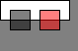
Colour Transparency
An optional argument can be used for fill() and stroke() to control transparency.
  0 completely transparent i.e. 0% opacity
  255 completely opaque i.e. 100% opacity
Examples:
  fill(255) is opaque white filling (default opacity is 100%)
  fill(0, 128) is semi-transparent black filling
  fill(255, 0, 0, 128) is semi-transparent red filling
background(128);
fill(255);
rect(0,0,70,20);
fill(0, 128);
rect(10,10,20,20);
fill(255, 0, 0, 128);
rect(40,10,20,20);

Slide 12
Using Colours
What will be drawn on the screen?
  A line, rectangle, and an ellipse
  A rectangle and an ellipse
  Only the ellipse
  Nothing
  This code has an error and won’t run.
noStroke();
line(30,30,50,30);
noFill();
rect(10,10,20,20);
stroke(255,0);
ellipse(50,50,20,20);

Slide 13
Using Colours
These two statements are exactly the same.
fill(255,255,255);
fill(255,255);
  True
  False

Slide 14
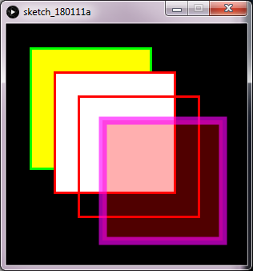
Use Colours!
1
Write a code to create the following sketch +2 points
Black background
Opaque filling
Green outline, thickness: 3
No filling
outline thickness: 3
Semi-transparent filling
Semi-transparent outline, thickness: 10

Slide 15
Aside: Hexadecimal Notation
RGB colours can be represented using Hexadecimal notation.
  Syntax: #RRGGBB
    The # denotes the hex notation
    RR is a two-digit hex number representing red value from 0 to 255
    GG is a two-digit hex number representing green value from 0 to 255
    BB is a two-digit hex number representing blue value from 0 to 255
Examples:
  fill(255,255,255) equivalent to fill(#FFFFFF)
  fill(128,196,64) equivalent to fill(#80C440)
  fill(0,0,255) equivalent to fill(#0000FF)

Slide 16
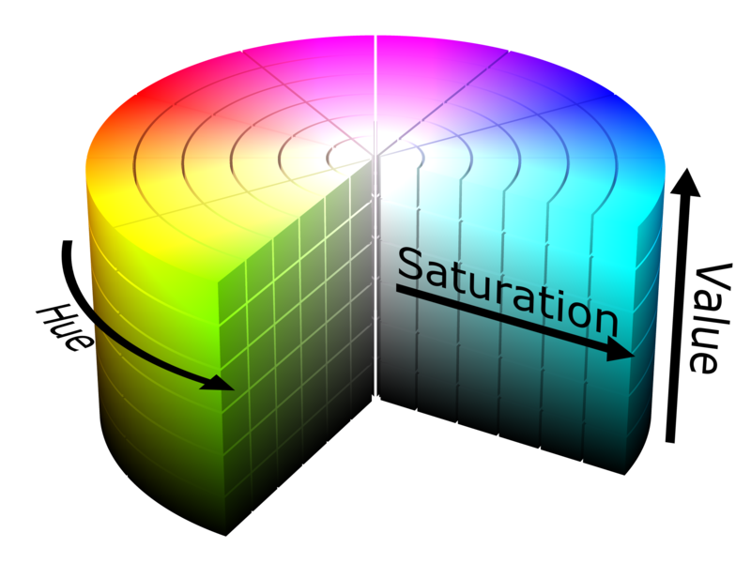

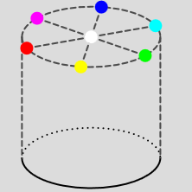


HSB Colour Model
In this mode, a colour is represented by three components
  Hue
    Dominant pure color.
  Saturation:
    Vibrancy of the color
    Range: 0 to 100
  Brightness
    How bright the color is.
    Range: 0 to 100
Brightness
Image adapted from wikipedia
A plane with all S and B values for Hue=0 (red)

Slide 17
Colour Question
What is the best description of HSB colour (350,90,95)?
  a shade of red
  a shade of blue
  Black
  White
  One of the ranges is invalid
Note: Assume the ranges (0-360,0-100,0-100)
0
60
Brightness

Slide 18
Colour Question
What is the best description of HSB colour (300,0, 50)?
  a shade of red
  a shade of blue
  a shade of gray
  black
  One of the ranges is invalid
Note: Assume the ranges (0-360,0-100,0-100)
0
60
Brightness

Slide 19
Colour Question
What is the best description of HSB colour (300, 99, 0)?
  a shade of red
  a shade of blue
  a shade of gray
  black
  One of the ranges is invalid
Note: Assume the ranges (0-360,0-100,0-100)
0
60
Brightness

Slide 20
Colour Question
What is the best description of HSB colour (200,0,150)?
  a shade of red
  a shade of blue
  Black
  White
  One of the ranges is invalid
Note: Assume the ranges (0-360,0-100,0-100)
0
60
Brightness

Slide 21
Colour Question
These two HSB colours look the same on the screen:
(200,0,50) and (50,0,50)
  True
  False
0
60
Brightness

Slide 22
HSB Ranges in Processing
While above ranges (i.e. 360,100,100) are standard in image processing, the Processing language uses 255,255,255 by default.
220
200
180
0
160
40
0
255
255
Brightness
0

Slide 23
Changing the Color Mode
By default, processing uses RGB mode with ranges from 0 to 255 for all color components R, G, and B.
Defaults can be changed using colorMode() function.
Syntax:
Examples:
  colorMode(RGB) RGB mode, use default ranges (0 to 255)
  colorMode(RGB,100) RGB mode, ranges: 0 to 100 for all colors
  colorMode(HSB) HSB mode, default ranges 0 to 255)
  colorMode(HSB,360,100,100) change defaults to 360,100,100
  colorMode(HSB,1) HSB, ranges 0 to 1.0 for all components
  colorMode(HSB,1,1,1,10) same as above, opacity is 0 to 10.
colorMode(mode)
colorMode(mode, max)
colorMode(mode, max1, max2, max3)
colorMode(mode, max1, max2, max3, maxA)

Slide 24
Changing the Colour Mode, cont’d
Be careful:
After changing the ranges with any of the statements above, those ranges will remain in use until they are explicitly changed again.
colorMode(RGB, 100, 100, 100); //ranges are 100 for all R,G,B components
colorMode(HSB); //ranges are still 100 for all H,S,B components

Slide 25
List of colour functions we learned today
background()
  Set background colour
stroke(), noStroke()
  Set stroke (line) colour and transparency
fill(), noFill()
  Set filling or text color and transparency
colorMode()
  Choose between RGB and HSB, and optionally set the range

Slide 26
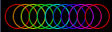

Examples
Note: don’t worry so much if you don’t remember for loops. We will go over it later.
size(140, 40);
background(0);
noFill();
colourMode(HSB, 100);
for (int i = 0; i <= 100; i+=10) {
stroke(i, 100, 100); //only change the hue in every iteration
ellipse(i+20, 20, 30, 30);
}
// this example is from Processing Documentation
colourMode(RGB, 100);
for (int i = 0; i < 100; i++)
for (int j = 0; j < 100; j++) {
stroke(i, j, 0);
point(i, j);
}

Slide 27
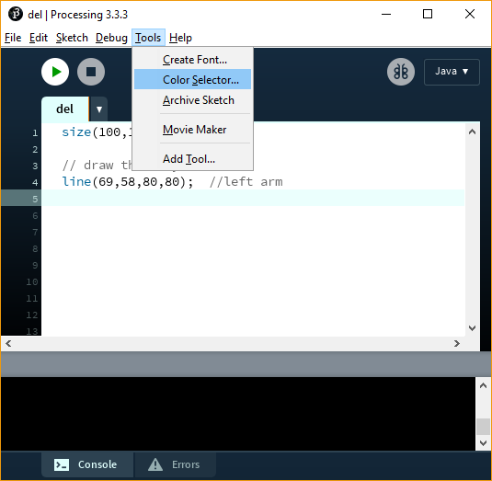
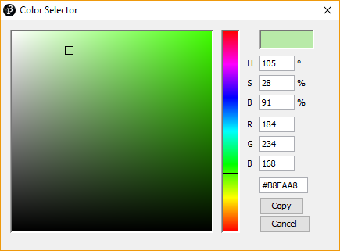
PDE Colour Selector Tool
You can use the PDE colour selector tool from the tools menu (Tools->Color Selector…) to get the values of your chosen color.
Current color
HSB values of current color
RGB values of current color
Hex representation for the RGB values

Slide 28
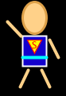
Update Your Design
Lecture Activity – Task 1
2
Add code to your character that you designed previously so that it has colours now ☺… remember, be creative with your colors and shapes.
Here is my design, but yours should be different

Slide 29
Active Programs

Slide 30
This is a pre-class reading materials.
After finishing reading the materials, you should be able to:
  Understand the difference between static and active modes.
  Understand the order of execution of active sketches.
  Create a simple animation using setup() and draw().
  Set the frame rate of an animation using frameRate()
  Know where to place size() and background()
  Use the system variables: mouseX, mouseY, width, height
  Stop an animation using noLoop()

Slide 31
Static vs Active Modes
All programs you have been writing so far are static sketches.
  A static sketch is a series of statements that aim to draw a single image; i.e.no animation or interaction.
An active sketch on the other hand aims to draw a series of images (each called a frame) that represent an animation.
Active sketches may be programmed to be interactive to user’s actions.
  Examples of actions: mouse movement, keyboard presses, etc.

Slide 32
How to Create Active Sketches
Two built-in functions: setup() and draw() are always called automatically.
  setup() runs once at the beginning
  Then draw() runs repeatedly.
The rate of running the draw method is called the framerate.
  The default is 60 fps, but it can be changed using the frameRate() function.
You can stop repeating draw() using noLoop() function.
start
void setup() {
...
}
void draw() {
...
}

Slide 33
Active Program Structure
void setup() {
// Step S₁
// Step S₂
// ...
// Step S_{n}
}
void draw() {
// Step D₁
// Step D₂
// ...
// Step D_{n}
}
The two curly brackets {} are used to define the beginning and end of a block of code
This part runs once and is used for initialization
This part loops forever and is used for animation
Order of execution: S₁, S₂, .., S_{n}, D₁, D₂, .., D_{n}, D₁, D₂, .., D_{n}, D₁, …etc

Slide 34
Drawing a Static Sketch with setup/draw
All these four programs produce the same output
  Justify?
without setup/draw
size(200,200);
background(255);
rect(10,10,40,40);
three different ways with setup/draw
void setup(){
size(200,200);
}
void draw(){
background(255);
rect(10,10,40,40);
}
void setup(){
size(200,200);
background(255);
}
void draw(){
rect(10,10,40,40);
}
void setup(){
size(200,200);
background(255);
rect(10,10,40,40);
}

Slide 35
Notes About Active Sketches
You can’t mix static and active modes!
  Once you use active mode, you can’t call any function, such as rect(), outside setup() and draw().
size() can only be executed once
  so it can’t be part of draw()
mix static & active
wrong place for size()
void setup(){
size(200,200);
}
void draw(){
background(255);
rect(10,10,40,40);
}
rect(10,10,40,40);
void setup(){
size(200,200);
}
void draw(){
background(255);
}
void setup(){
}
void draw(){
size(200,200);
background(255);
rect(10,10,40,40);
}
✓
✗
✗

Slide 36
Mouse Location
Processing has two keywords (system variables) that will always contain the current coordinates of the mouse cursor.
  mouseX and mouseY contain mouse location (x,y) in current frame.
  Default value is 0 for both variables.

Slide 37
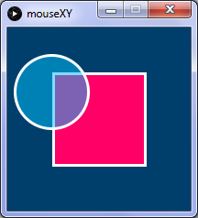
A Shape Following the Mouse
1(a)
In this example, the ball follows the mouse position.
void setup() {
size(200, 200);
stroke(255);
strokeWeight(3);
}
void draw() {
background(0,63,107);
fill(255,0,102);
rect(50,50,100,100);
fill(0,192,255,130);
ellipse(mouseX, mouseY, 80, 80);
}

Slide 38
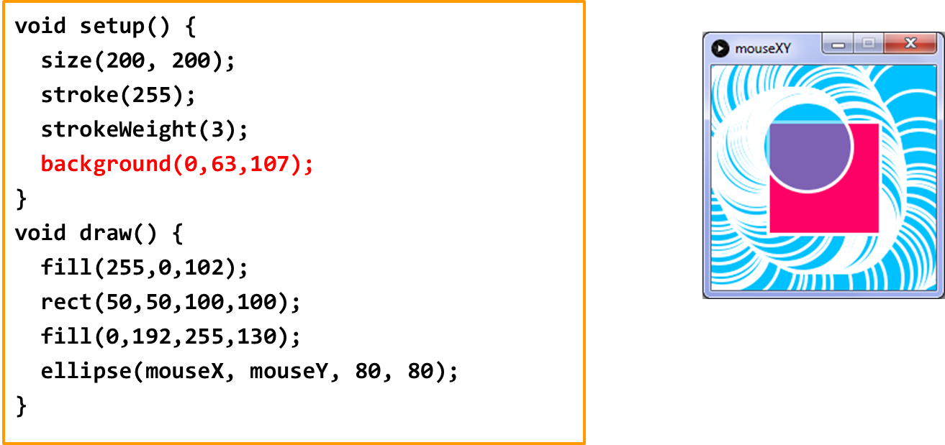
Where to put background()
If placed in draw(), it clears the sketch at beginning of every frame
  i.e. it flood the sketch with some color.
If placed in setup(), it sets the background of first frame only and doesn’t clear subsequent frames.
If you move background() to setup(), this would be the output from the previous example.

Slide 39
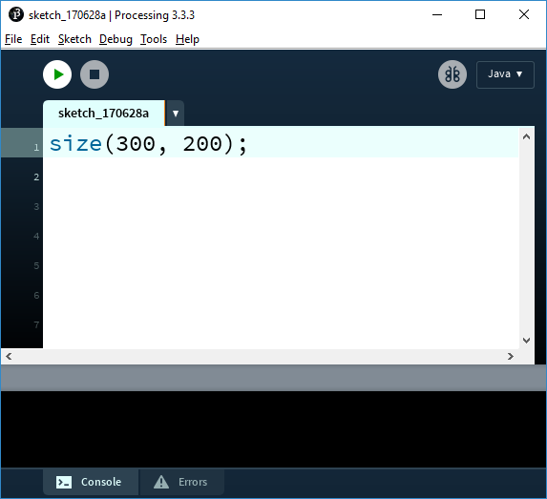
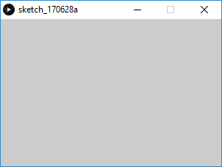
Window’s width and height
There are to more useful system variables: width and height that contain the size of the current display window.
  We set these two values using the size() function.
  Default value is 100 if size() is not used.
width
300 pixels
200 pixels
height

Slide 40
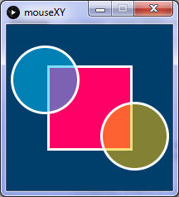
Two Shapes Controlled by the Mouse
2
In this example, we create a second ball positioned at the inverse of the cursor position.
void setup() {
size(200, 200);
stroke(255);
strokeWeight(3);
}
void draw() {
background(0,63,107);
fill(255,0,102);
rect(50,50,100,100);
fill(0,192,255,130);
ellipse(mouseX, mouseY, 80, 80);
fill(255,192,0,130);
ellipse(width-mouseX, height-mouseY,80,80);
}

Slide 41
Function Automatically Called
Which of these functions is automatically called by the system once we run the program?
  size(200,200);
  setup() and draw()
  noLoop()
  rect(0,0,width,height);
  ellipse(0,0,width,height);

Slide 42
Frame Rate
The default frame rate is ____ and it can be changed using the function ______
  15, frameRate()
  60, frameRate()
  15, setFrameRate()
  60, setFrameRate()
  None of the above

Slide 43
Where to write code?
Which code is valid?
void setup(){
...
}
void draw(){
size(100,100);
...
}
  None of the above.
size(100,100);
void setup(){
...
}
void draw(){
...
}
void setup(){
size(100,100);
...
}
void draw(){
...
}

Slide 44
Where to write code?
Which code clears a the display window at the beginning of each frame?
void setup(){
size(200,200);
}
void draw(){
background(255);
rect(5,5,90,90);
}
  None of the above; I have a better answer.
background(255);
void setup(){
size(200,200);
}
void draw(){
rect(5,5,90,90);
}
void setup(){
size(200,200);
background(255);
}
void draw(){
rect(5,5,90,90);
}
Question: what is the difference between A, B, and C?

Slide 45
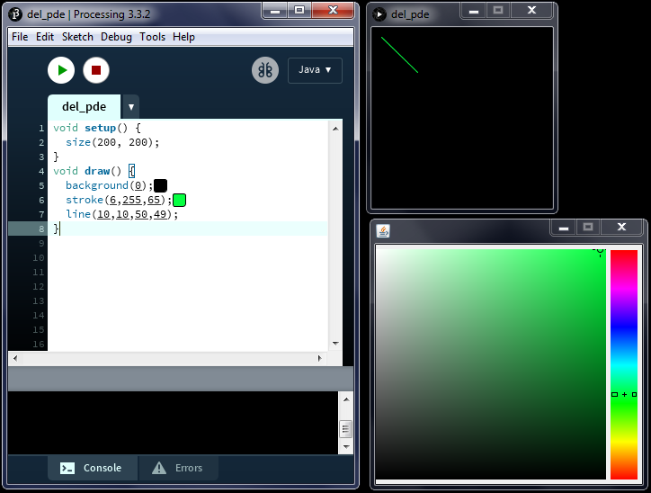
Tweaking Your Sketch At the Runtime
Tweak Mode (Sketch-> Tweak) runs the code so that you can change some color and variable values while the code is running and see instant feedback.
Notes:
  This only applies to active mode.
  You need to save your program before you can tweak it.

Slide 46
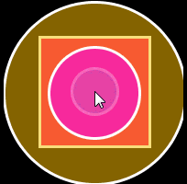
Animation based on Mouse Location
1
Build on the code in the pre-class materials and use the mouse coordinates (mouseX, mouseY) to control other attributes in the animation, e.g. size, transparency, color, background, etc.
Be creative! For example, in this animation →
    I added a third circle, then had the size of each shape change differently:
      Circle1: radius = mouseX + mouseY
      Circle2: radius = mouseX/2
      Circle3: radius = mouseY*2
      Box: size depends on mouseX and mouseY
    Controlled shapes’ location with mouse location.
    Changed the background color based on the combined size of all circle.
  Your interactive animation doesn’t have to
  have any purpose for now, just try to make
  it look cool and have fun ☺
+3 points

Slide 47
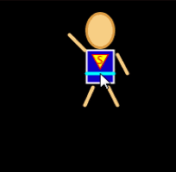
Moving YOUR Character
Lecture Activity – Task 2
2
Referring to the character you designed previously, add code to your program so that the character moves with your mouse cursor.
Hint: the location of all shapes of your character should depend on mouseX and mouseY
Here is the output (Your character could be different):
+3 points

Slide 48
Active Programs (2)
Pre-Class Reading

Slide 49
This is a pre-class reading materials. After reading them, you should be able to:
  Use mouse location from previous frame (pmouseX, pmouseY)
  Generate random numbers using random()
  Write programs that are driven by mouse and key events
    1) Using mouse functions:
      mousePressed(), mouseReleased(), mouseClicked(),
      mouseMoved(), mouseDragged()
    2) Using key functions:
      keyPressed(), keyReleased()

Slide 50
Mouse Location… revisited!
You have seen before that Processing has two system variables that hold the current coordinates of the mouse cursor
  mouseX and mouseY contain mouse location (x,y) in current frame.
Furthermore, processing has two more system variables that will always hold the previous coordinates of the mouse cursor.
  pmouseX and pmouseY contain (x,y) from the frame previous to the current frame (if used inside the draw() function).
Default value is 0 for all four variables.

Slide 51
pmouseX and pmouseY
You can use pmouseX and pmouseY whenever you want to use the mouse location in the previous frame.
1st frame
2nd frame
3rd frame
4th frame
mouseX mouseY
pmouseX pmouseY
mouseX mouseY
pmouseX pmouseY
mouseX mouseY
pmouseX pmouseY
mouseX mouseY
pmouseX pmouseY
0
0
10
10
20
20
50
30
0
0
0
0
10
10
20
20
T I M E

Slide 52
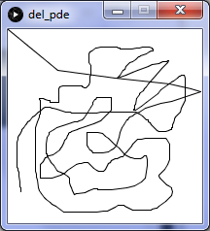
pmouseX and pmouseY
1
We can use previous mouse coordinates is to draw a continuous line.
Note where we placed background.
Task: change the framerate to 4 fps and check the output
void setup() {
size(200, 200);
background(255); // don’t clear previous frame
}
void draw() {
line(pmouseX, pmouseY, mouseX, mouseY );
}

Slide 53
Mouse and Key Events
While setup() & draw() are always invoked automatically, there are functions that are invoked based on users input.
Functions that are called based MOUSE events:
  mousePressed(): called whenever a mouse button is clicked
  mouseReleased(): called whenever a mouse button is released
  mouseClicked(): called after a mouse button is pressed then released.
  mouseMoved(): called whenever the mouse moves and the mouse button is not clicked
  mouseDragged(): called whenever the mouse moves and the mouse button is clicked
Functions that are called based KEY events:
  keyPressed(): called whenever a key is pressed.
  keyReleased(): called whenever a key is released.

Slide 54
Overall Structure of Active Programs
start
void setup() {...}
setup runs once
then
draw runs many times per second
mouse functions are automatically called when a mouse event happens
Key functions are automatically called only when a key event happens
void draw() {...}
void mouseClicked(){...}
void mousePressed() {...}
void mouseReleased(){...}
void mouseDragged() {...}
void mouseMoved(){...}
void keyPressed() {...}
void keyReleased() {...}

Slide 55

Event Driven Program
2
In this example, a new circle is drawn wherever the mouse is clicked. The color of the circle is random.
Also, whenever a key is pressed, the sketch is cleared!
void setup() {
size(200, 200);
colorMode(HSB,360,100,100); //HSB mode is used
background(360,0,100); //white background
noStroke();
}
void draw() {// nothing here}
void mousePressed() {
fill(random(360),100,100,128); //random color
ellipse(mouseX, mouseY, 40, 40);
}
void keyPressed() {
background(360,0,100); //clear sketch
}
Question: what happens if we add background() to draw()?

Slide 56
Active Programs (2)

Slide 57
The Pre-Class Reading
The pre-class materials covered the following:
  New keywords: pmouseX, pmouseY
  New functions : random()
  New event-driven functions
    automatically invoked based on MOUSE events:
      mousePressed(), mouseReleased(), mouseClicked(),
      mouseMoved(), mouseDragged()
    automatically invoked based on KEY events:
      keyPressed(), keyReleased()

Slide 58
Mouse Location
Which of the following keeps track of mouse location from previous frame?
  mouseX , mouseY
  pmouseX , pmouseY
  pFrame.x, pFrame.y
  pFrame.mouseX, pFrame.mouseY
  none of the above

Slide 59
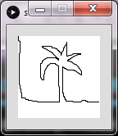
Drawing a continuous line
Which of the following can be used to draw a continuous line?
  Either A or B E. All of them
void setup(){ background(255); }
void draw() {
line(pmouseX, pmouseY , mouseX, mouseY);
}
void setup(){ background(255); }
void draw() {
line(mouseX, mouseY, pmouseX, pmouseY );
}
void setup(){ }
void draw() {
background(255);
line(mouseX, mouseY, pmouseX, pmouseY );
}

Slide 60
Event Based Programming
Which of these functions is automatically called whenever the user presses the mouse button and moves the mouse at the same time.
  mouseReleased
  mousePressed
  mouseDragged
  mouseMoved
  Both B and C

Slide 61
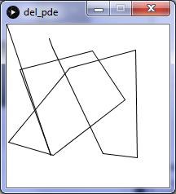
Framerate
Which framerate has most probably produced this output?
  60
  45
  30
  25
  5
void setup() {
size(200, 200);
background(255);
stroke(0);
framerate(????);
}
void draw() {
line(pmouseX, pmouseY, mouseX, mouseY);
}

Slide 62
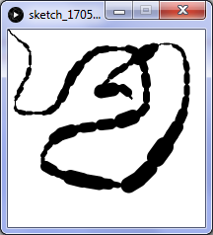
Mouse Speed
1
this code is from the pre-
class readings and is used
to draw a continuous line.
Modify the code so that the thickness of the line is controlled by the mouse speed. Here are some hints:
void setup() {
size(200, 200);
background(255);
stroke(0);}
void draw() {
//... add code here ...
line(pmouseX, pmouseY, mouseX, mouseY );
}
  Mouse Speed is the distance the mouse travel per unit of time. Therefore, speed can be computed in terms of the distance the mouse travels in each new frame.
    i.e. difference between current mouse position and previous one
  Use abs() function to avoid negative values.
  Don’t worry too much about having accurate calculations.

Slide 63
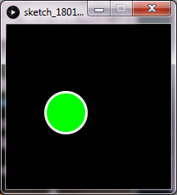
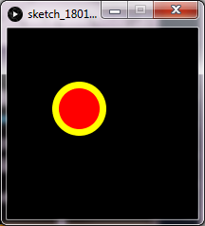
Mouse Events
2
Create a program that draws a circle which follows the mouse (same location as the mouse)
The circle should be:
  red with thick, yellow outline as long as the mouse is pressed.
  green with thin, white outline as long as the mouse is not pressed.
Don’t use variables or conditional statements
Mouse key is not pressed
Mouse key is pressed

Slide 64

Aside: smooth() and noSmooth()
By default, all geometry is drawn with smooth (anti-aliased) edges. However, you can control this behaviour using smooth() function to enable this feature, and noSmooth() function to disable smoothing.
Notes:
  You don’t need to run smooth() as it is the default behaviour.
    You may use it if you want to change the anti-aliasing level (1,2,4,8) – the default level 2; i.e. smooth(2)
  The maximum anti-aliasing level is determined by the hardware of the machine running the software
    i.e. no guarantee that smooth(4) and smooth(8) will work on your computer.
  Use both functions inside the setup() function.
noSmooth() smooth()

Slide 65
Coordinates Transformation

Slide 66
How to translate, rotate, and scale the coordinates
Coordinates are reset before every new frame.
Transformation is cumulative within each frame.
Order is important when combining more than one transformation.
Storing and restoring coordinate systems.
How to use transformed coordinates in static and dynamic programs.

Slide 67
The Default Coordinate System
By default, the coordinate system has its origin at the upper-left corner of the window, with x and y coordinates as shown in the figure.
This default representation can be transformed, i.e. translated, rotated, and scaled using built-in functions:
  translate(), rotate(), scale()
Only shapes drawn after the transformation use the new coordinates.
Coordinates are reset at the beginning of each new frame (inside draw())
(30,20)
x
(0,0)
(40,70)
y
A 100x100 window

Slide 68
Coordinate Translation - translate()
The translate() function moves the origin to a new location.
translate() applies only to shapes drawn after the function call
You can think of translate is if you are adding its arguments to all shapes that come after it. i.e. (30,10) + (40,40) = (70,50)
(0,0)
(30,20)
x
(-40,-40)
(-10,-20)
x
(0,0)
translate(40,40)
(30,20)
y
(70,50)
y

Slide 69
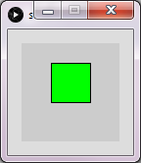
translate() in static mode
1
// move origin 30 px right and 20 px down
translate(30, 20);
fill(0,255,0);
rect(0, 0, 40, 40); // Draw at new origin
(0,0)
Remember that we can think of the output as if we add the translation value to the location of rectangle (assuming the original is still at top-left corner). That is,
  The (x,y) of the green rectangle is (0+30,0+20) if the original is still at top-left corner.

Slide 70
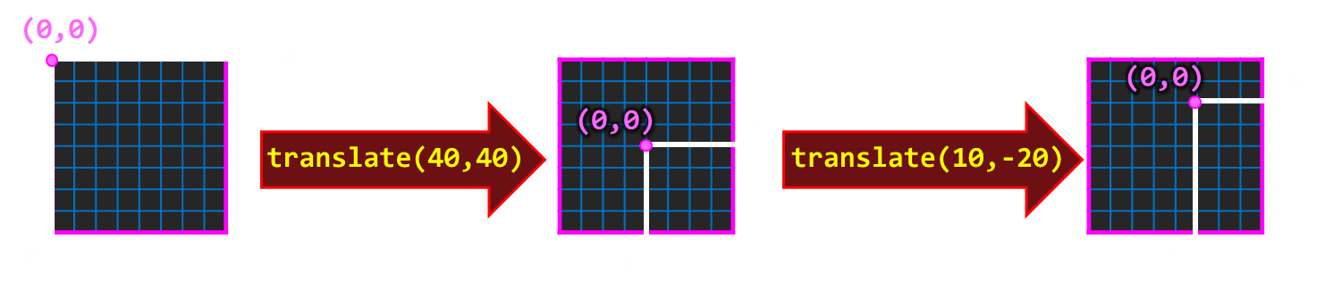
Coordinate Translation - translate()
translate() is cumulative within each frame.
However, the coordinates are reset for each new frame.
  i.e. if you use transform the coordinates within draw() method, the next frame assumes default origins and then translate again.
(0,0)
x
x
(0,0)
(0,0)
x
translate(40,40)
translate(10,-20)
y
y
y
draw()
Reset Coordinates

Slide 71
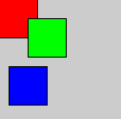
translate() in static mode
2
// Draw rect at default origin
fill(255,0,0); // Red
rect(0, 0, 40, 40);
// move origin 30 px right and 20 px down
translate(30, 20);
fill(0,255,0); // Green
rect(0, 0, 40, 40); // Draw at new origin
// move origin again 20 px left and 50 px down
translate(-20, 50);
fill(0,0,255); // Blue
rect(0, 0, 40, 40); // Draw rect at new
Another way of thinking of the output is that we add the translation value to the location of shapes drawn after the function call. That is,
  The (x,y) of the green rectangle is (0+30,0+20)
  The (x,y) of the blue rectangle is
  (0+30-20,0+20+50)

Slide 72
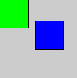
translate() in dynamic mode
3
void draw() {
// every beginning of new frame, default origin at (0,0) is used
fill(0,255,0); // Green
rect(0, 0, 40, 40); // Draw rect at new origin
translate(50, 30); // move origin to (50, 30)
fill(0,0,255); // Blue
rect(0, 0, 40, 40); // Draw rect at new origin
}

Slide 73
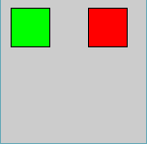
translate() in dynamic mode
void setup() {
size(150, 150);
// origin moved initially
translate(80, 0);
// Draw rect at new origin
fill(255,0,0); // red
rect(10, 10, 40, 40);
}
void draw() {
// origin automatically reset to (0,0)
// Draw rect at new origin
fill(0,255,0); // Green
rect(10, 10, 40, 40);
}

Slide 74

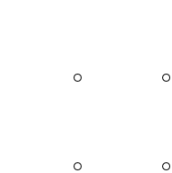
Moving all items with the mouse
4
void draw() {
background(255);
// Translate to the mouse location
translate(mouseX, mouseY);
ellipse( 30, 30, 6, 6);
ellipse(-30, 30, 6, 6);
ellipse( 30, -30, 6, 6);
ellipse(-30, -30, 6, 6);
}
Q1: is there another way to write the code without translate()?
Q2: what is the benefit of using translate() over the other method?
(remember the exercise of moving your character with the mouse)
Example based on textbook

Slide 75

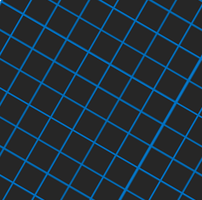
Coordinate Rotation - rotate()
The rotate() function rotates the axes to a new angle.
It has one parameters, the angle specified in radians.
Similar to translate(), rotate() is cumulative and applies only to shapes drawn after the function call.
Note: rotate(PI) is the same as rotate(radians(180))
(0,0)
x
(0,0)
x
(70,10)
rotate(PI/6)
y
y
(70,10)

Slide 76
Coordinate Rotation - rotate()
The rotate() function rotates the axes to a new angle.
It has one parameters, the angle specified in radians.
Similar to translate(), rotate() is cumulative and applies only to shapes drawn after the function call
(70,10)
rotate(PI/6)
(70,10)

Slide 77
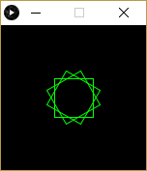
rotate() Example
5
size(150, 150);
background(0);
noFill();
stroke(0, 255, 0); // green outline
rectMode(CENTER);
translate(75, 75); // origin at sketch center
rotate(PI/6); // rotate 30 degrees
rect(0, 0, 40, 40);
rotate(PI/6); // rotate 30 degrees more
rect(0, 0, 40, 40);
rotate(PI/6); // rotate 30 degrees more
rect(0, 0, 40, 40);
Q. Link statements to shapes in sketch.

Slide 78
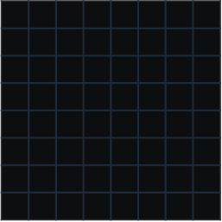
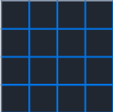
Coordinate Scaling - scale()
The scale() function scales the coordinate system so that shapes are drawn in a different scale (this also affects pixel and border size).
  Two functions: scale(size) and scale(xsize, ysize)
Similar to other transforms, rotate() is cumulative and applies only to shapes drawn after the function call
(0,0)
x
(0,0)
x
(20,20)
(20,20)
scale(2.0)
y
y

Slide 79
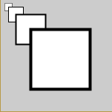
scale() Example
6
size(150, 150);
scale(0.5); // scale is 50%
rect(10, 10, 20, 20);
scale(2); // now scale is back to 100%
rect(10, 10, 20, 20);
scale(2); // scale is 200%
rect(10, 10, 20, 20);
scale(2); // scale is 400%
rect(10, 10, 20, 20);
Q. Link statements to shapes in sketch.

Slide 80
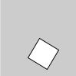
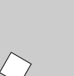
Order Matters!
Order is important when combining more than one transformation.
50
In the first example, the coordinates are translated first then rotated
In the second example, the coordinates are rotated first then translated.
// translate then rotate
translate(50, 50);
rotate(PI/6);
rect(0, 0, 30, 30);
50
// rotate and translate
rotate(PI/6);
translate(50, 50);
rect(0, 0, 30, 30);
50
50

Slide 81
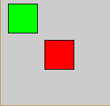
Storing and Restoring Coordinates
The coordinate system is saved as a transformation matrix.
You can use pushMatrix() and popMatrix() to store and restore the current coordinate system.
Example:
size(150,150);
pushMatrix(); // save current origin
translate(50, 50); //origin at (50,50)
fill(255,0,0); //red
rect(10,10,40,40);
popMatrix(); //retrieve last stored origin
fill(0,255,0); //green
rect(10,10,40,40);

Slide 82
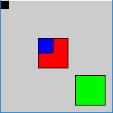
Aside: stacking transformations
You can use pushMatrix() and pushMatrix() multiple times
  This case, the will be added/removed using the “matrix stack”.
size(150,150);
pushMatrix(); // save default origin
translate(50, 50); //origin at (50,50)
fill(255,0,0); rect(0,0,40,40); //red
pushMatrix(); // save current transformation
translate(50,50); // origin at (100,100)
fill(0,250,0); rect(0,0,40,40); //green
popMatrix(); // restore prev origin - (50,50)
fill(0,0,250); rect(0,0,20,20); //blue
popMatrix(); // restore original origin (0,0)
fill(0); rect(0,0,10,10); //black

Slide 83
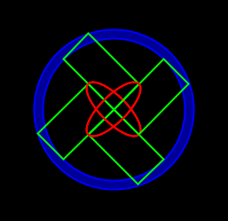
Coordinate Transformation
Lecture Activity – Task 3
1
[3 points] Write code to produce the output below. You can only use rect() and ellipse() functions to draw the shapes. All shapes must be located at (x,y) = (0,0), i.e. the origin of the shape is (0,0) – use coordinate transformation to place the shapes.

Slide 84
Moving YOUR Character using transform()
Lecture Activity – Task 4
2
[1 point] Previously, you moved your character by adding mouseX and mouseY to every (x,y) of all shapes in your character.
Today, we will move the character using a simpler technique.
1) copy your character code from Exercise2 in the “Color” slides
2) add one statement at the beginning to move (translate) your character.

Slide 85
Variables, Data Types, and a bit of Math
Pre-Class Reading
Part(A)

Slide 86
This is a pre-class reading materials. After reading them, you should be able to:
  Define value, variable, and memory location
  Create and use variables of different data types
  recognize the naming rules and guidelines for variables.
  List and compare the data types in processing.
  Define and use the “color” type.
  Creating and using constants.
  Properly use math operators.
  Evaluate math expressions.

Slide 87
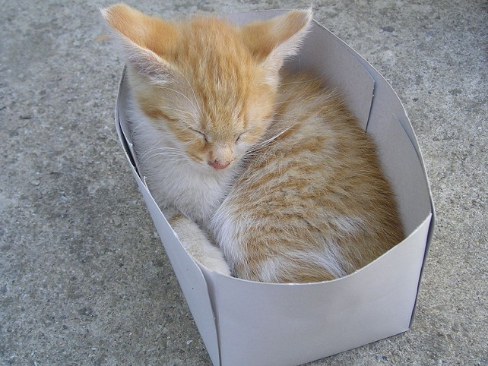
Values, Variables, and Locations
A value is a data item that is manipulated by the computer.
A variable is the name that the programmer uses to refer to a location in memory.
A location has an address in memory and stores a value.
Variable
Location
age
Value (cute cat)
18
Value
Location
(box)
100
petbox
Variable
(label)
Address

Slide 88
Values, Variables, and Locations
Let’s say we want to store a number that represents the age.
  Step #1: Declare variable by giving it a NAME and a TYPE.
int age; // age can only store integers
    The computer allocates space for the variable in memory (at some memory address). Every time we give the name age, the computer knows what data item we mean.
  Step #2: Initialize the variable to have a starting value. E.g.,
  age = 21;
  Step #3: Value stored in a location can be changed throughout the program to whatever we want using assignment ("=" symbol).
  age = age + 3;
Memory
Variable Name Lookup Table
16
???
21
24
Name Location Type
age 16 int
20
24

Slide 89
Variable Name
A variable must have a NAME and a TYPE.
Names (aka identifiers):
  are case sensitive (B is not the same as b)
  can be a sequence of characters that include only letters, digits, underscores ( _ ), and dollar signs ($).
  must start with a letter, an underscore (_), or a dollar sign ($).
    cannot start with a digit.
  can not be a reserved word.
    E.g. cannot be called double, true, false, or null.
  Naming guidelines
    can be of any length, but reasonable (readable) length is preferred.
    should start with a lower case letter.
    if more than one word, remove the spaces and capitalize all words after the first one (e.g. my first car → myFirstCar)

Slide 90
Variable Type
A variable must have a name (identifier) and a type. Each type has a valid range of values and uses a different amount of memory space.
Note: Unlike JavaScript, where you don’t specify a type (i.e. just use var), in Java (and Processing) you must specify the variable type.
 | Type | Size in memory | Range
whole numbers | byte | 8 bits | -2⁷ to 2⁷-1 (-128 to 127)
 | short | 2 bytes | -2¹⁵ to 2¹⁵-1 (-32768 to 32767)
 | int | 4 bytes | -2³¹ to 2³¹-1
 | long | 8 bytes | -2⁶³ to 2⁶³-1
real numbers | float | 4 bytes | e.g. 17.345f
 | double | 8 bytes | e.g. 12452.212 (more accurate)
characters | char | 2 bytes | e.g. 'a', '1‘and '?'
boolean | boolean | 1 byte | true or false

Slide 91
The String Type
Strings are sequences of characters inside double quotes (i.e. text in double quotes).
Example:
  The first statement creates (defines) a variable and initializes its value to “Abdallah Mohamed”.
  The second statement is assigns a new value to existing variable.
The concatenation operator is used to combine two strings into a single string. The notation is a plus sign '+'.
String personName = "Abdallah Mohamed";
personName = "John Smith";
String firstName = "Abdallah", lastName = "Mohamed";
String fullName = firstName + lastName;

Slide 92
The Color Type
Processing introduces a new data type called color which stores color information. The value of a color variable can be set by the color() function.
color red = color(255,0,0); // red in RGB mode
color navy = color(#443F76); // navy in hex notation (RGB)
colorMode(HSB,360,100,100);
color green = color(128,100,100);// green in HSB mode
color blue = color(#0011FF); // blue in hex notation (RGB)
background (navy); // navy background
fill(red);
rect(10,10,40,40); // red square
fill(green);
rect(50,50,40,40); // green square
fill(blue);
ellipse(75,25,30,30); // green square
red uses RGB as it was defined before changing the color mode
blue uses RGB even though it was defined after setting the color mode because blue was defined using hex notation

Slide 93
Declaring and Initializing Variables
1
// Declaring Variables
double a; // Declare a to be a double variable
int x, y; // Declare x and y as integer variables
// Assignment Statements
a = 7.1; // Assign 7.1 to a;
x = 1 + 3; // assign 4 to x;
y = x + 2; // assign 6 to y;
// Declaring and Initializing in ONE Step
double a2 = 7.1;
int x2 = 1, y2 = 2;

Slide 94
Using Variables
2
Here are two more examples of two variables x and y
int x; // declare a variable
x = 5; // initialize a variable – what is assignment ‘=’?
int y = 10; // declare and initialize a variable
println(x); // print value of x
x = 10; // overwrite old value
println("x " + x); //what is the output?
int x = 10, y; // y has no values yet
y = x; // y is 10 now
y = y + 1; // = does not mean equal, it means assignment.
println("x + y = " + (x + y)); //notice the output

Slide 95

Constants
Constants are similar to variables except that once initialized they cannot change.
To create a constant, use the keyword final before your variable declaration.
Naming Convention:
  Capitalize all letters in constants
    e.g. MAX, PI, SIZE
  Use underscores for multiple words.
    e.g. MAX_VALUE

Slide 96
Expressions

Slide 97
The Assignment Statement
An assignment statement changes the value of a variable.
  The variable on the left-hand side of the = is assigned the value from the right-hand side.
  The value may be changed to a constant, to the result of an expression, or to be the same as another variable.
  The values of any variables used in the expression are always their values before the start of the execution of the assignment.
Example:
int A, B;
A = 5;
B = 10;
A = 10 + 6 / 2;
B = A;
A = 2*B + A - 5;
Question: What are the values of A and B?

Slide 98
Expressions
An expression is a sequence of operands and operators that yield a result. An expression contains:
  operands - the data items being manipulated in the calculation
    e.g. 5, "Hello, World", myDouble
  operators - the operations performed on the operands
    e.g. +, -, /, *, % (modulus or remainder after integer division)
An operator can be:
  unary - applies to only one operand
    e.g. d = -3.5; // “-” is a unary operator, 3.5 is the operand
  binary - applies to two operands
    e.g. d = 3 * 5.0; // “*” is binary operator, 3 and 5.0 are operands
Integer Division:
  5 / 2 if both operands are integers, the output is an integer 2
  5.0 / 2 if at leas one operand is float, output is float 2.5

Slide 99
Division Operator
Self Assessment Questions…
What is the result of 25 / 4?
How would you rewrite the expression if you wished the result to be a floating-point number?
Are the following statements correct? If so, show the output.
println("25 / 4 is " + 25 / 4);
println("25 / 4.0 is " + 25 / 4.0);
println("3 * 2 / 4 is " + 3 * 2 / 4);
println("3.0 * 2 / 4 is " + 3.0 * 2 / 4);

Slide 100
The Remainder Operator (%)
The % operator returns the remainder of two numbers.
Examples:
  Operation Result
  14 % 6 2
  -34 % 5 - 4 (matches numerator sign)
  -34 % -5 - 4
  34 % -5 4
  5 % 1 0
  1 % 5 1
  3 % 0 runtime error. Can’t divide by zero

Slide 101
Operator Precedence
Each operator has its own priority similar to their priority in regular math expressions:
  Any expression in parentheses is evaluated first starting with the inner most nesting of parentheses.
  Unary + and unary - have the next highest priorities.
  Multiplication and division (*, /, %) are next.
  Addition and subtraction (+,-) are then evaluated.

Slide 102
The ++ and -- Operators
It is very common to subtract 1 or add 1 from the current value of an integer variable.
There are two operators which abbreviate these operations:
  ++ add one to the current integer variable
  - - subtract one from the current integer variable
Example:
var j=0;
j++; // j = 1; Equivalent to j = j + 1;
j--; // j = 0; Equivalent to j = j - 1;

Slide 103
Augmented Assignment
The operators +, -, *, /, and % can be combined with the assignment operator = to form augmented operators.
x += 5; //Equivalent to x = x + 5
x -= 5; //Equivalent to x = x - 5
x *= 5; //Equivalent to x = x * 5
x /= 5; //Equivalent to x = x / 5
x %= 5; //Equivalent to x = x % 5

